Slide 1
Design of Home Automation System Using IoT Technology
Ndubuisi Iwuala
Kingsley Asonye

Slide 2
Outline
Introduction
Objective
Design Requirements
Design Constraints
Design Method
System Diagram
Implementation Plan
Team Organization/Responsibilities
Project Timeline and Delivery Plan
Implementation of Tasks
ABET Outcomes
Acknowledgements
Conclusion

Slide 3
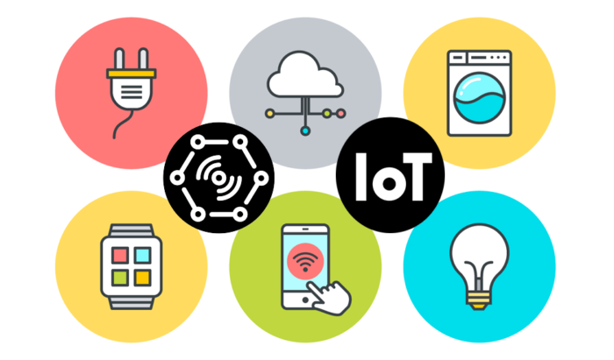
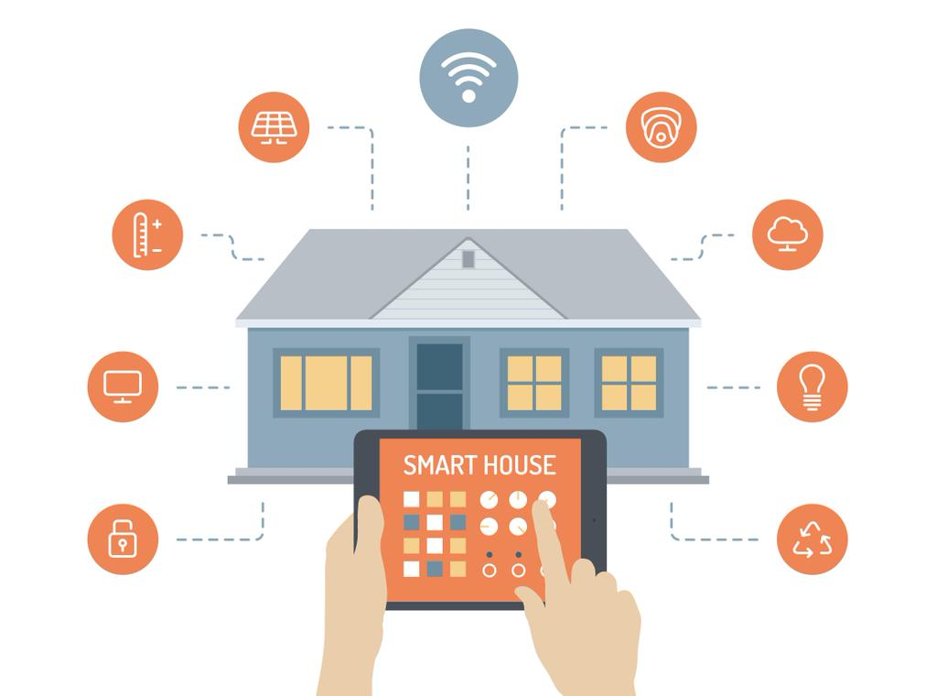
Introduction
Home automation is valuable in our lives because it makes tasks more convenient & can save you money on utilities. IoT technology also creates a connection between various devices to send and receive data efficiently.

Slide 4
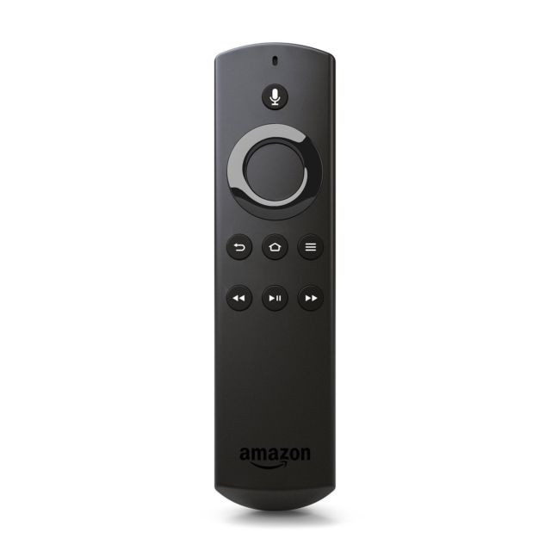
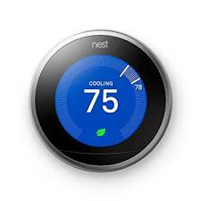
Examples of IoT devices on the market
SMART REMOTE
Nest thermostat

Slide 5
Objective
The objective of this project is to design a voice-controlled system that will allow a user to control appliances with spoken commands, as well as an open/close system that will notify users if the door, window, etc. is open

Slide 6
Design Requirements
Lights (Lamp) will be controlled by voice
Temperature functions will be controlled by voice
Television functions will be controlled by voice
User will be notified with front door is opened
Current & target temperature as well as unit setting will be displayed

Slide 7
Design Constraints
Internet connectivity is required due to the use of IoT devices
AVS (Alexa Voice Services) for voice control capability
$250 Budget

Slide 8
Design Method
AVS Prototype on Raspberry Pi
Remote Control Design
Alexa Skill Program
Data Channel for Television, Temperature, and Lights
Temperature Control Design
AWS Lambda Program
Open/Close Sensing Design
Light Control Design
Encasing Design
Design Verification

Slide 9

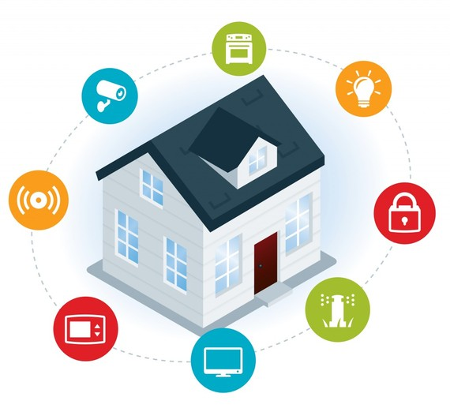
System Description
This home automation system is controlled by the Raspberry Pi. The Pi takes the role of an Amazon Echo, which receives a spoken command and then executes the command given. Design control will be created for each appliance along with programming the NodeMCU, an IoT device. This will ensure the command is executed by the appliance.

Slide 10
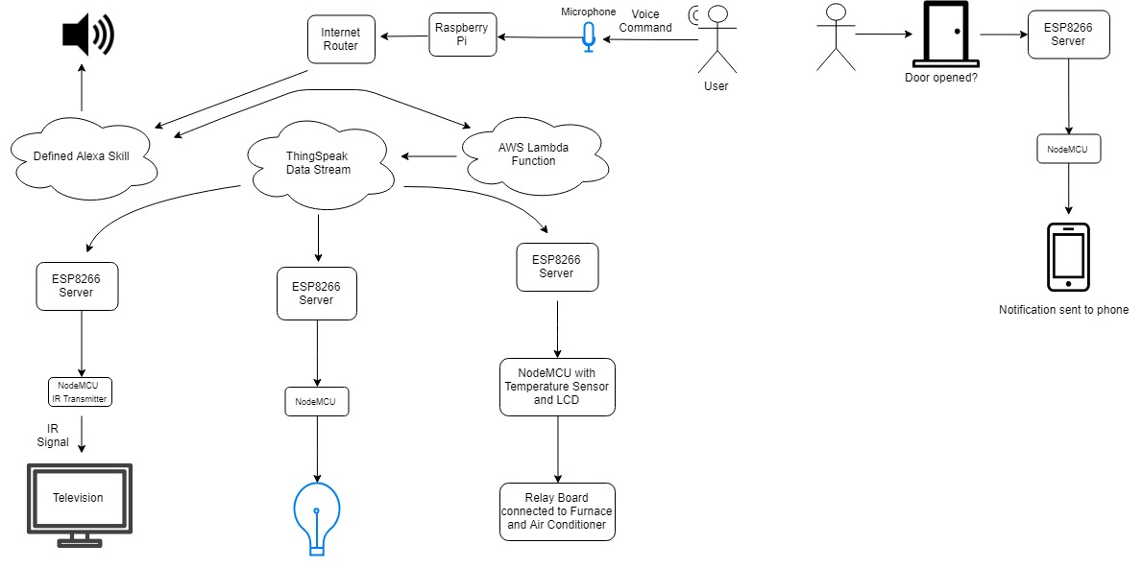
System Diagram

Slide 11
System Function

Slide 12
Implementation Plan
Task 1. Create AVS Prototype on Raspberry Pi (Ndubuisi)
Task 2. Alexa Skill Program (Ndubuisi)
Task 3. Data Channel setup for the television, temperature, and lights. (Ndubuisi)
Task 4. AWS Lambda Function (Ndubuisi)
Task 5. Remote Control Design (Kingsley/Ndubuisi)
Task 6. Temperature Control Design (Kingsley/Ndubuisi)
Task 7. Stand-Alone Light Control Design (Kingsley/Ndubuisi)
Task 8. Open/Close Detection Design (Kingsley/Ndubuisi)
Task 9. Design Verification (Kingsley/Ndubuisi)

Slide 13
Project Timeline & Delivery Plan
/
Time | Task | Comments | Responsible Personnel
Week 1 | Begin Task 1 | Create AVS Prototype on Raspberry Pi | Ndubuisi
Week 2 | Begin Subtask 2.1, 2.2, 2.3 | Alexa Skill Program | Ndubuisi
Week 3 | Finish Task 2 & Begin Task 3 | Data Channel Setup | Ndubuisi
Week 4 | Finish Task 3 & Being Subtask 4.1, 4.2, 4.3 | 4 weeks needed to complete AWS Lambda Function for Light, Thermostat, and Television Control | Ndubuisi
Week 5 | Continue Subtask 4.1, 4.2, 4.3 | N/A | Ndubuisi
Week 6 | Continue Subtask 4.1, 4.2, 4.3 | N/A | Ndubuisi
Week 7 | Begin Subtask 5.1, 5.2, 5.3 3 & Finish Subtask 4.1, 4.2, 4.3 | 4 weeks needed to complete Subtask 5.1, 5.2 5.3. Task 5 will carry over to next semester. | Ndubuisi/Kingsley
Week 8 | Continue Subtask 5.1, 5.2, 5.3 | N/A | Kingsley
Week 9 | Continue Subtask 5.1, 5.2, 5.3 | N/A | Kingsley
Week 10 | Finish Subtask 5.1, 5.2, 5.3 & Begin Subtask 6.1 & 6.2 | 4 weeks needed to complete Subtask 6.1 & 6.2. Task 6 will carry over to next semester. | Kingsley
Week 11 | Continue Subtask 6.1, 6.2 | N/A | Kingsley
Week 12 | Continue Subtask 6.1, 6.2 | N/A | Kingsley
Week 13 | Finish Subtask 6.1, 6.2 & Begin Subtask 7.1, 7.2 | 4 weeks needed to complete Subtask 7.1, 7.2. Task 7 will carry over to next semester | Kingsley
Week 14 | Continue Subtask 7.1, 7.2 | N/A | Kingsley
Week 15 | Continue Subtask 7.1, 7.2 | N/A | Kingsley
Week 16 | Begin Task 8 | 4 weeks needed to complete all Subtasks for Task 8. | Ndubuisi/Kingsley
Week 17 | Begin Subtask 5.4, 5.5, 5.6 | 4 weeks needed to complete Subtask 5.4, 5.5, 5.6 | Ndubuisi/Kingsley
Week 18 | Continue Subtask 5.4, 5.5, 5.6 | N/A | Ndubuisi/Kingsley
Week 19 | Begin Subtask 6.3, 6.4, 6.5 & Subtask 7.3, 7.4 | 3 weeks needed to complete Subtask 6.3, 6.4, 6.3 & Subtask 7.3, 7.4 | Ndubuisi/Kingsley
Week 20 | Finish Subtask 5.4, 5.5, 5.6 & Task 8 | Finish & Finalize remote and open/close designs | Ndubuisi/Kingsley
Week 21 | Finish Subtask 6.3, 6.4, 6.5 &7.3, 7.4 & Begin Task 8 | Finish & Finalize Temperature | Ndubuisi/Kingsley
Week 22 | Begin Task 9 | Begin Design Verification | Ndubuisi/Kingsley

Slide 14
Implementation of Tasks

Slide 15
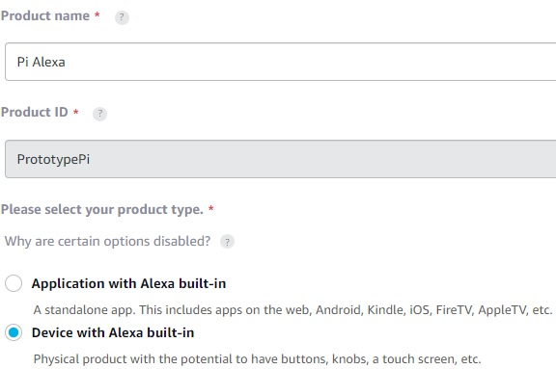
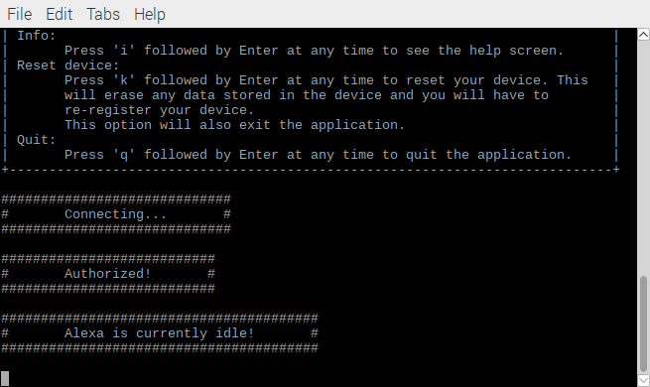
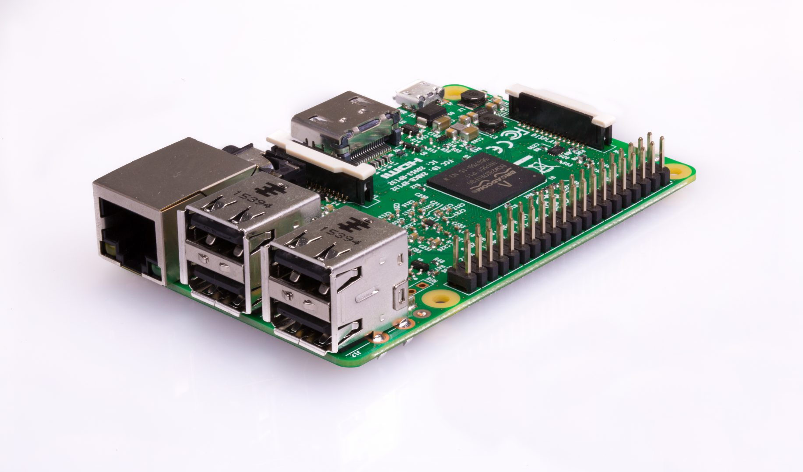
Implementation of Task 1
Registered Raspberry Pi with Alexa Voice Services
Used product and security IDs to authorize pi for Alexa use
Create AVS Prototype on Raspberry Pi

Slide 16
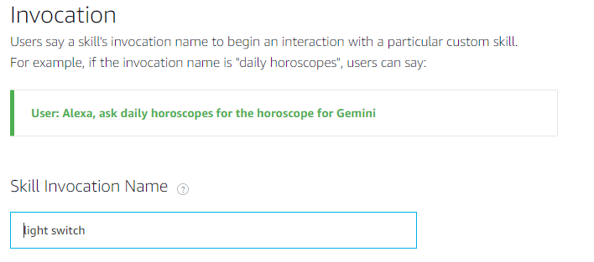
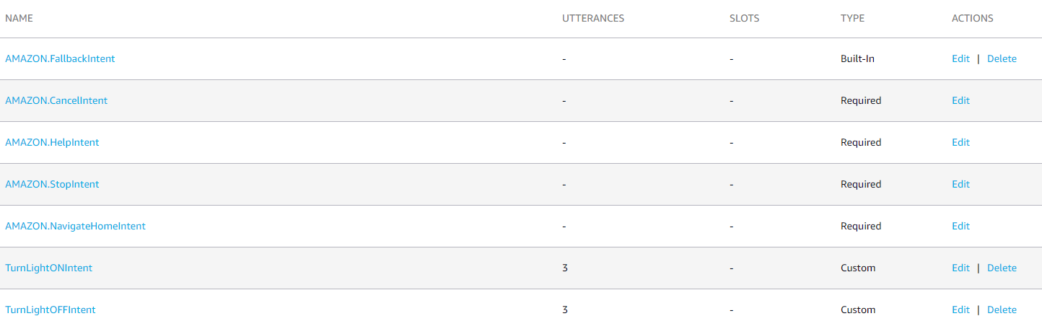
Implementation of Task 2
Created custom intents for each skill.
Mapped sample utterances for each skill
Program Alexa Skill for light control
Program Alexa Skill for television remote control function
Program Alexa Skill for thermostat control function

Slide 17
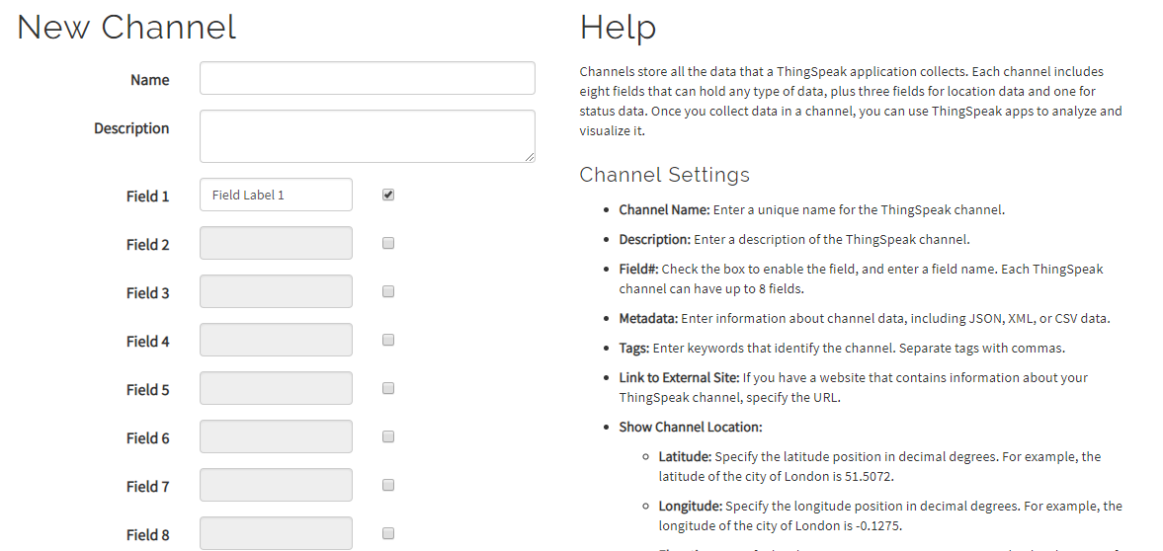
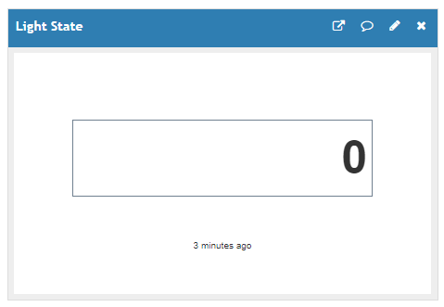
Implementation of Task 3
Create a data channel for the television, temperature, and lights

Slide 18
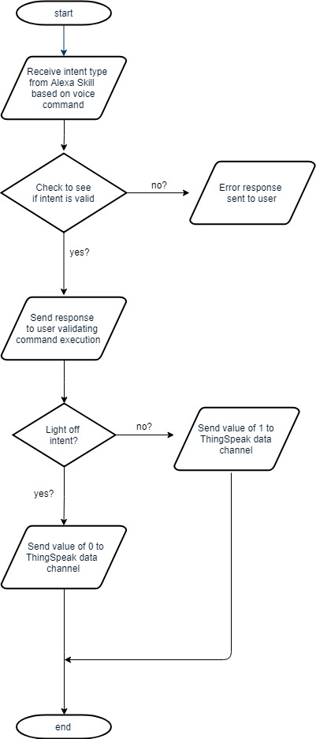
Implementation of Task 4.1
Light Control Flowchart
Program Lambda functions for light control

Slide 19
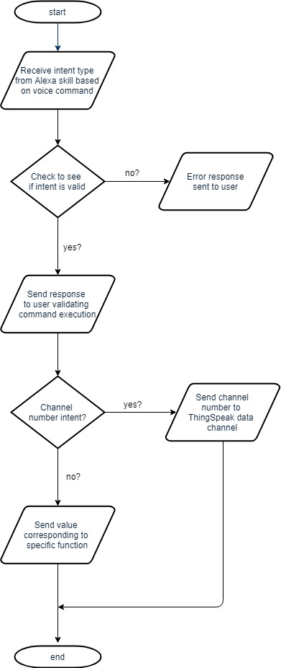
Implementation of Task 4.2
Television Control Flowchart
Program Lambda function for television control

Slide 20
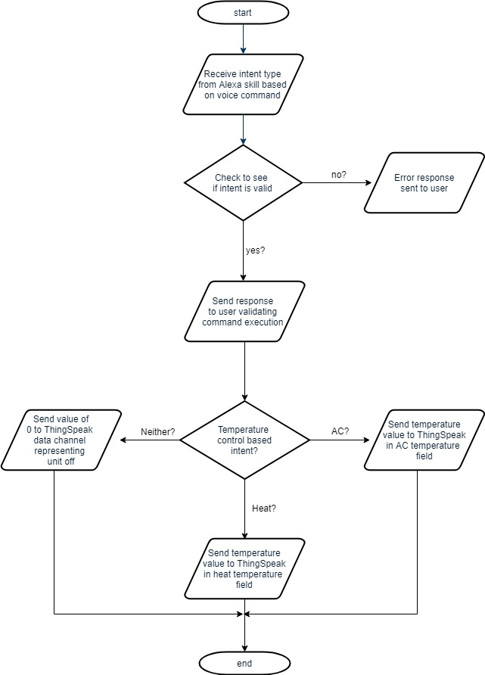
Implementation of Task 4.3
Temperature Control Flowchart
Program Lambda function for temperature control

Slide 21
Implementation of Task 5

Slide 22
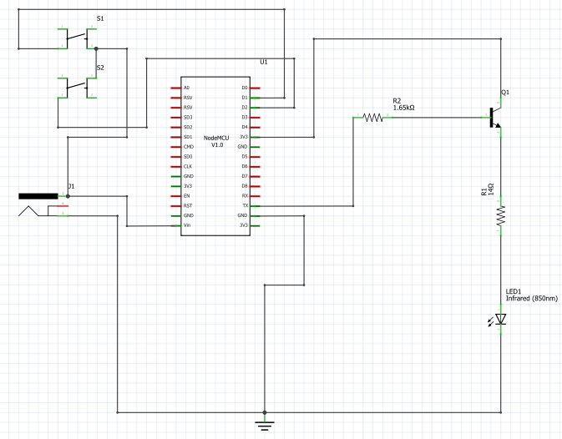
Implementation of Task 5.1
Schematic of IR transmitter circuit
Create schematic for IR transmitter

Slide 23
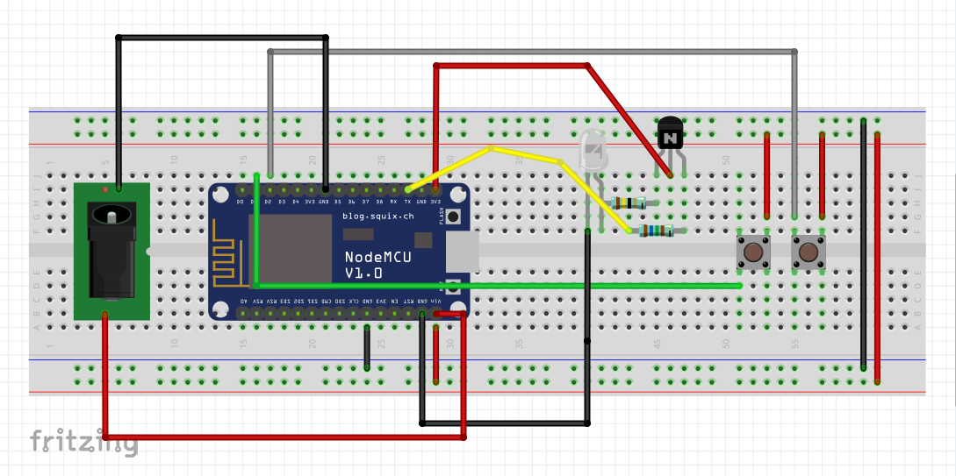
Implementation of Task 5.1 (cont.)
IR Transmitter Breadboard Design
Create breadboard design for IR transmitter

Slide 24
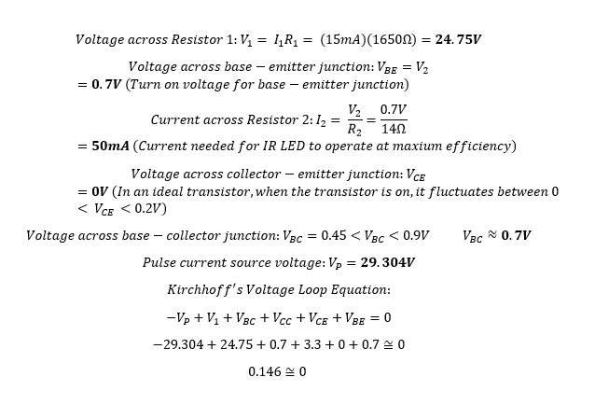
Implementation of Task 5.2
Calculations for IR Transmitter Circuit
Circuit Design Simulation (calculations)

Slide 25
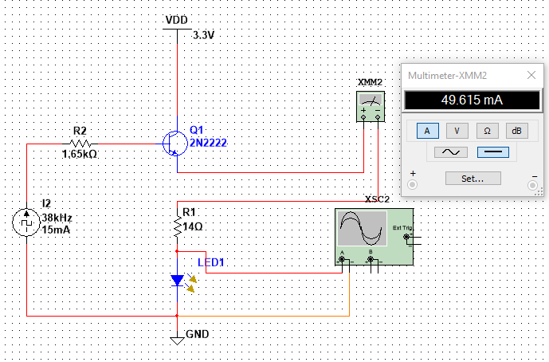
Implementation of Task 5.2 (cont.)
Simulation of IR transmitter circuit
Circuit design simulation

Slide 26
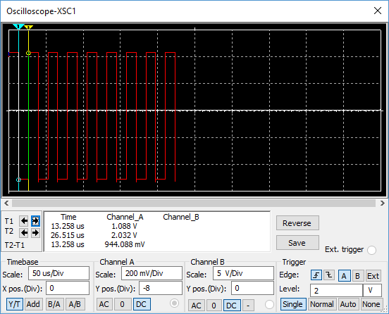
Implementation of Task 5.2 (cont.)
Simulation Results
Circuit design simulation (results)

Slide 27
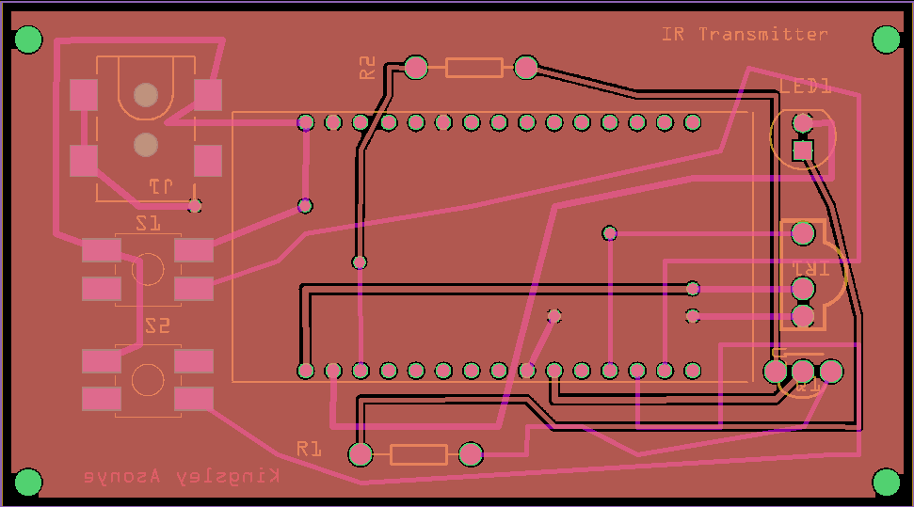
Implementation of Task 5.3
PCB Design of IR Transmitter
PCB Design of IR Transmitter circuit

Slide 28
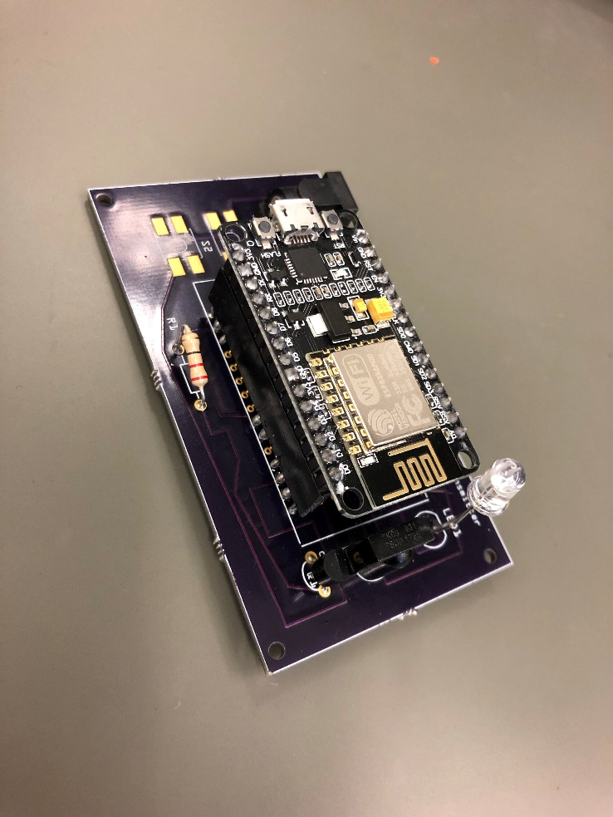
Implementation of Task 5.4
Soldered components to PCB for Television Control

Slide 29
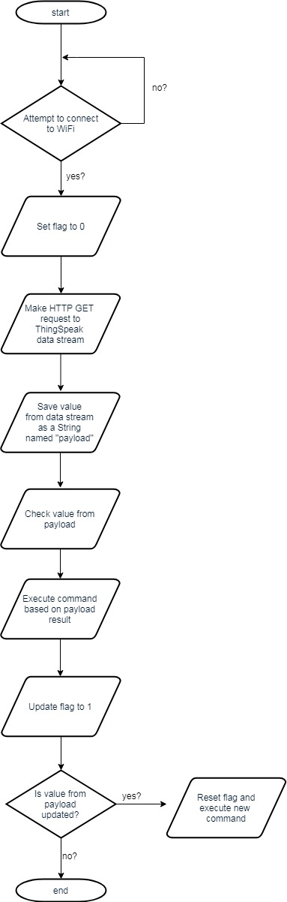
Implementation of Task 5.5
Program NodeMCU for Remote Control Design

Slide 30
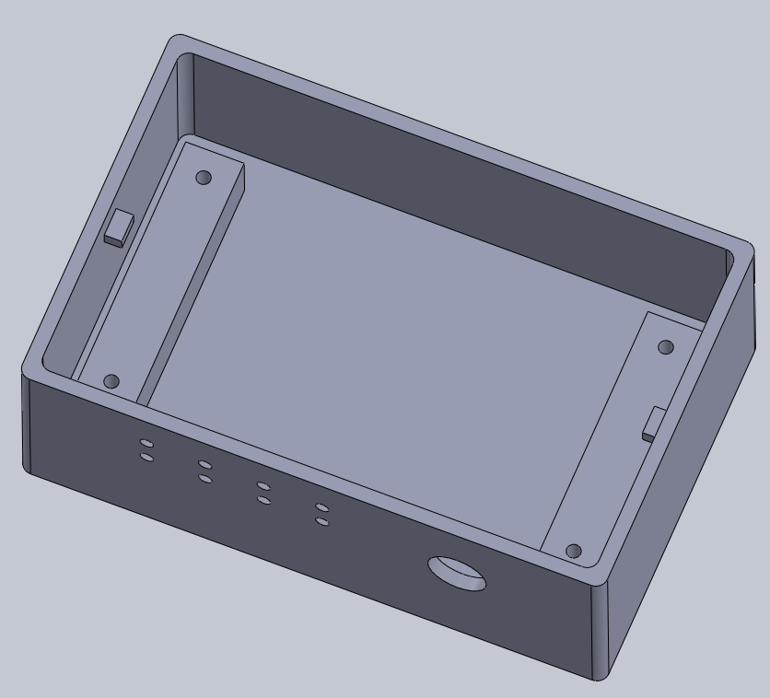
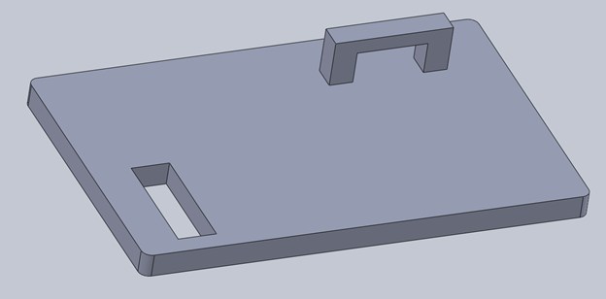
Implementation of Task 5.6
Encasing Design for IR Transmitter
CAD for Encasing of IR Transmitter

Slide 31
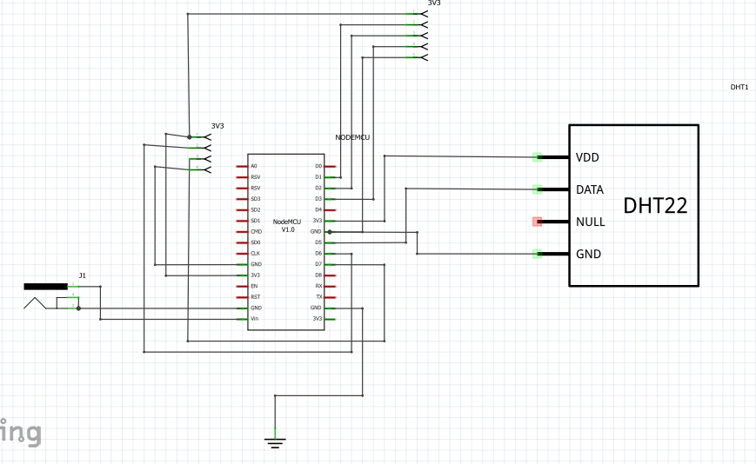
Implementation of Task 6.1
Temperature Control Schematic Design
Create schematic for temperature control

Slide 32
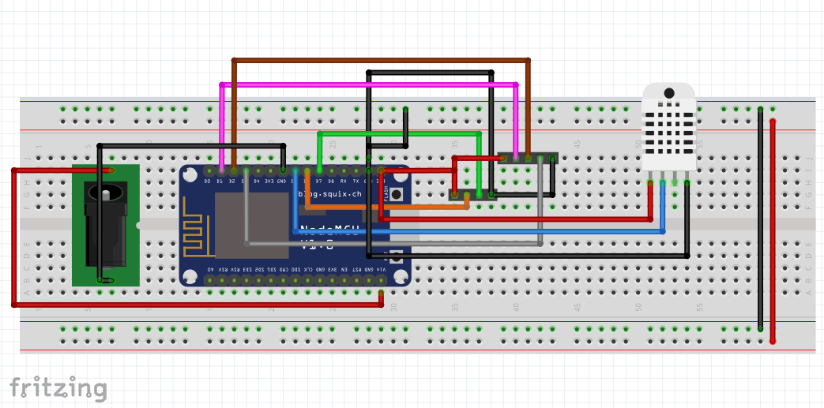
Implementation of Task 6.1 (cont.)
Temperature Control Breadboard Design
Create breadboard design for temperature control

Slide 33
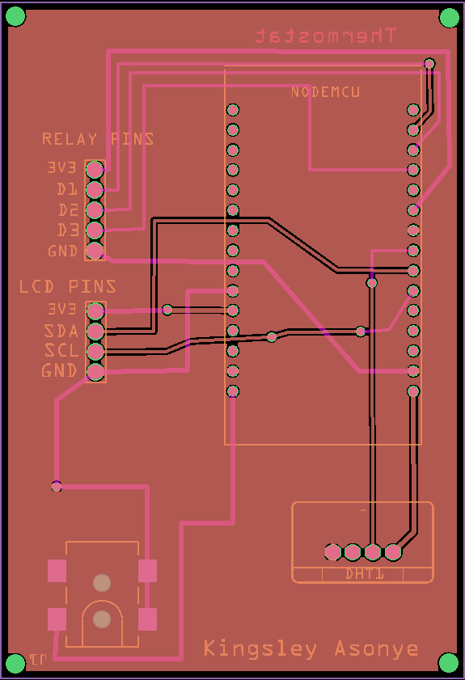
Implementation of Task 6.2
PCB Design for Temperature Control
PCB design of temperature control

Slide 34
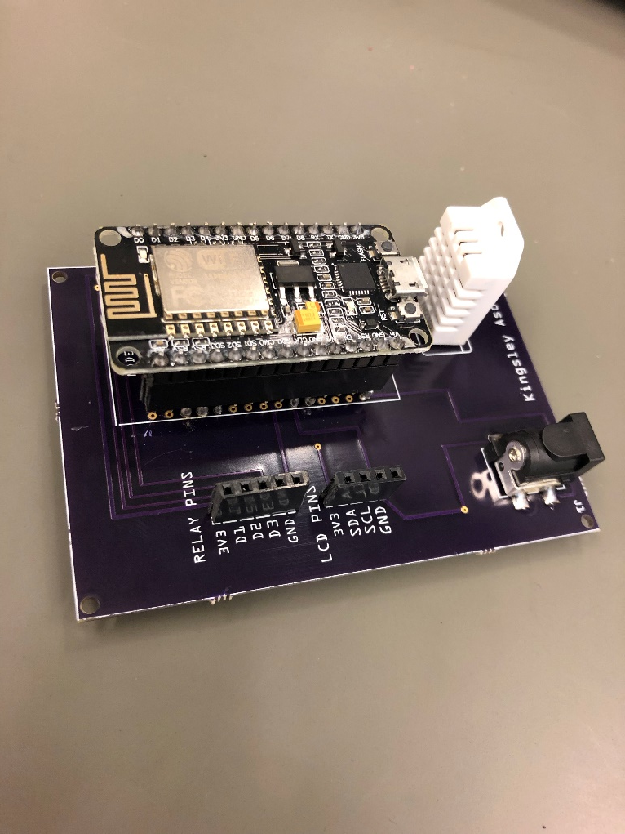
Implementation of Task 6.3
Soldered components to PCB for Temperature Control

Slide 35
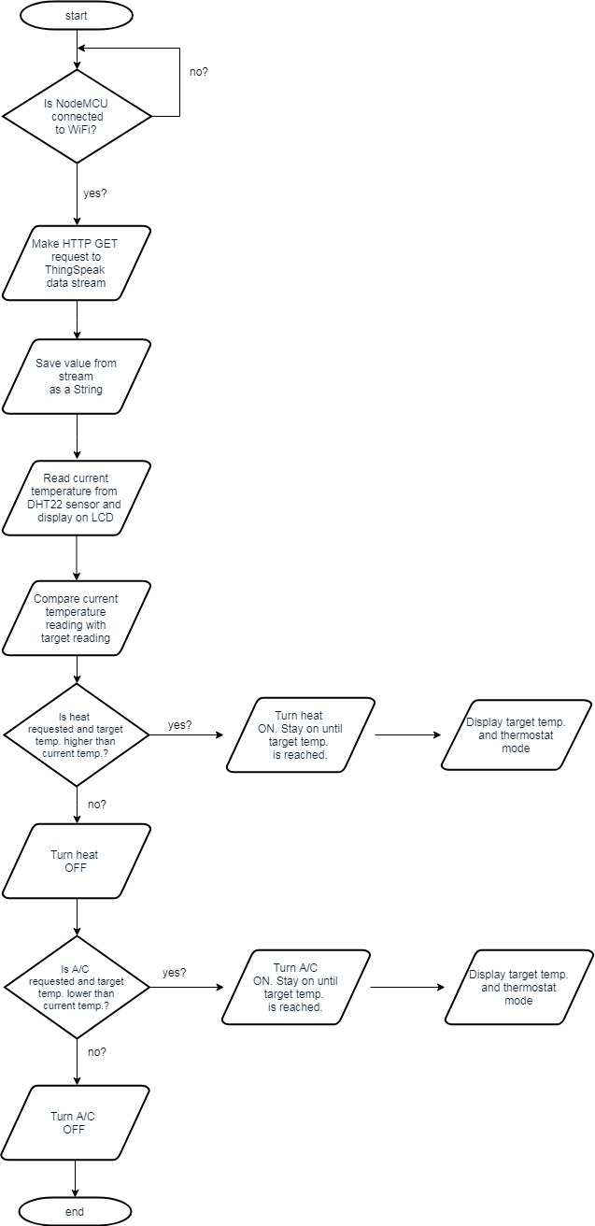
Implementation of Task 6.4
Program NodeMCU for Temperature Control Design

Slide 36
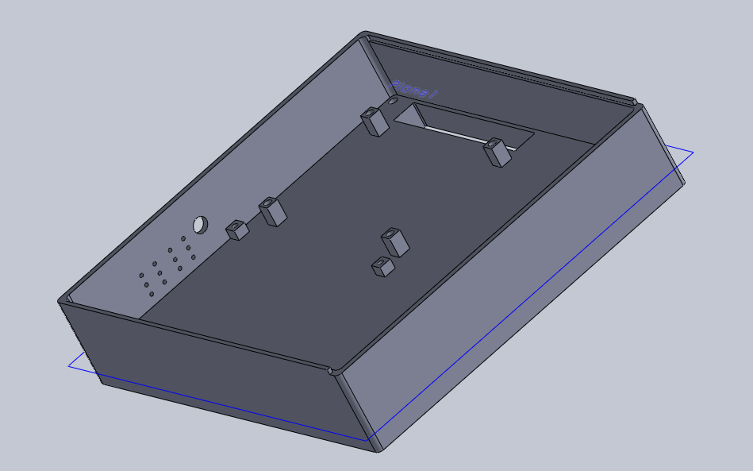
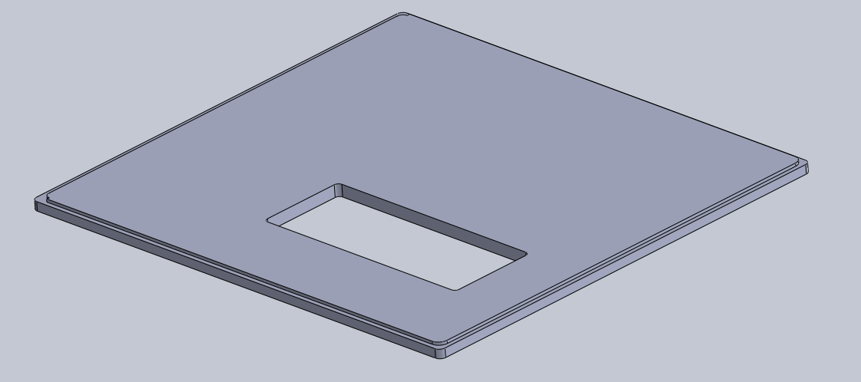
Implementation of Task 6.5
Encasing Design for Temperature Control

Slide 37
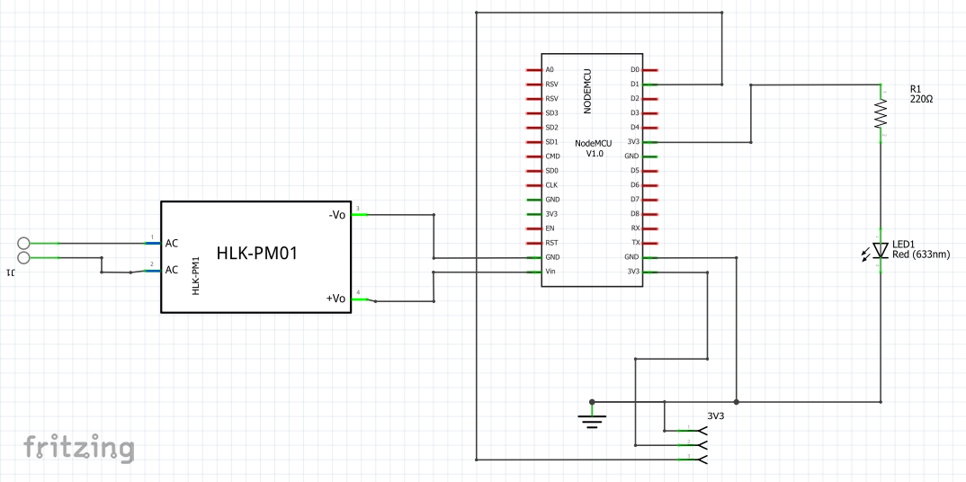
Implementation of Task 7.1
Light Control Schematic Design
Create schematic for Light Control

Slide 38
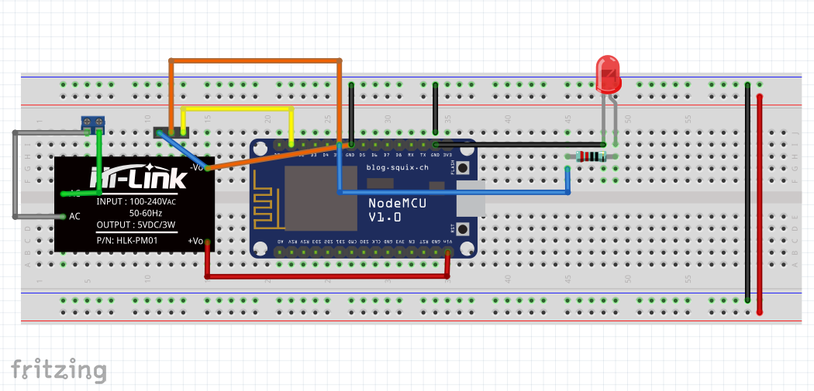
Implementation of Task 7.1 (cont.)
Light Control Breadboard Design
Breadboard Design of Light Control

Slide 39
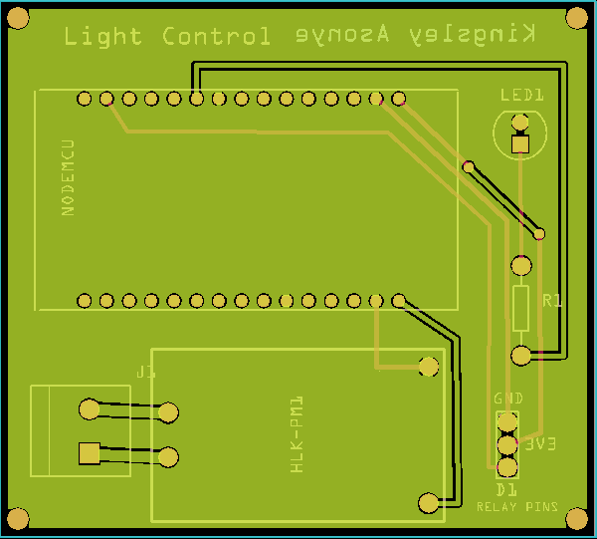
Implementation of Task 7.2
PCB Design of Light Control
PCB design for Light Control

Slide 40
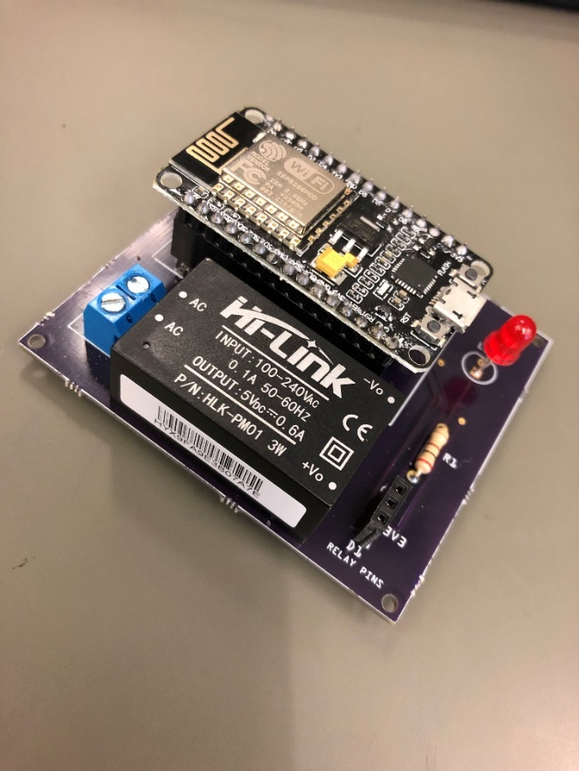
Implementation of Task 7.3
Soldered components to PCB for Light Control

Slide 41
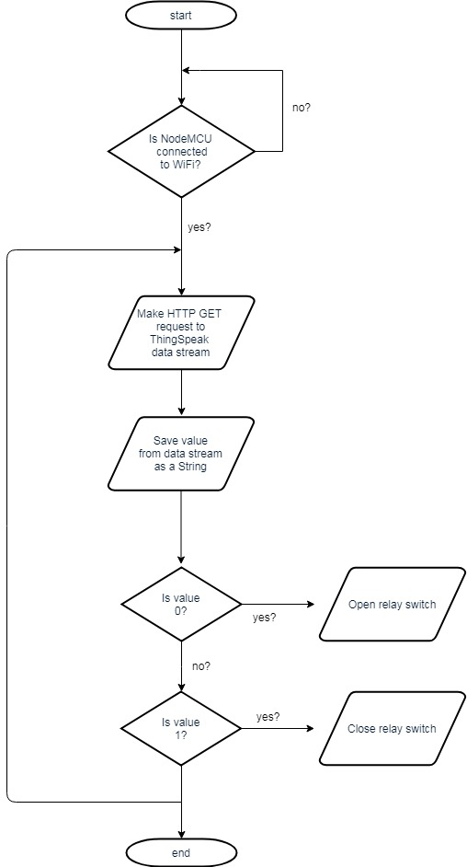
Implementation of Task 7.4
Program NodeMCU for Light Control Design

Slide 42
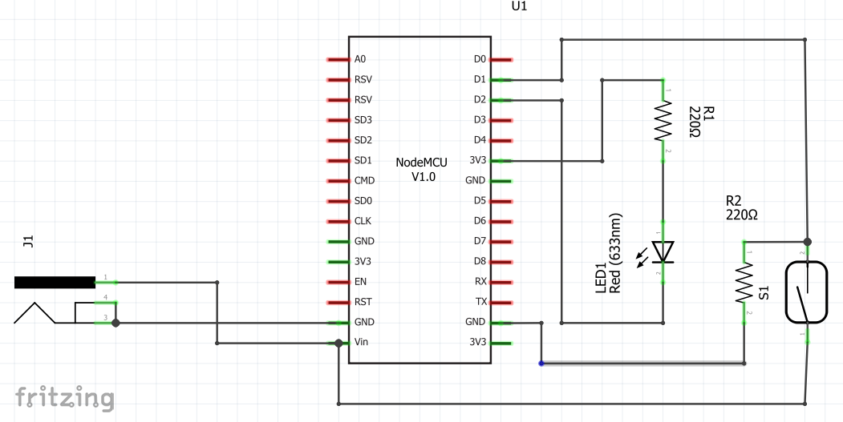
Implementation of Task 8.1
Schematic of Open/Close Detection System
Schematic Design of the Open/Close Detection System

Slide 43
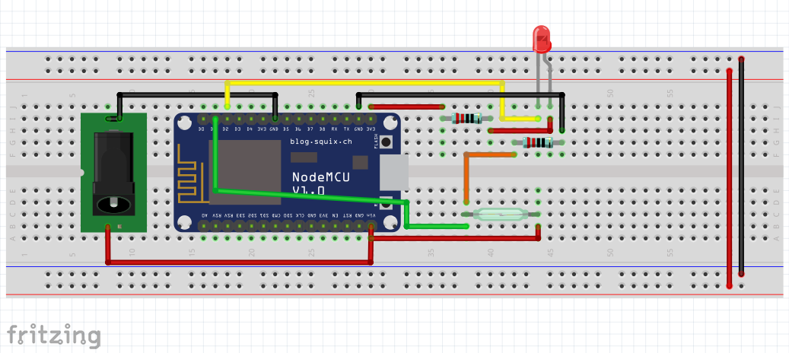
Implementation of Task 8.1(cont.)
Breadboard Design of Open/Close Detection System
Breadboard Design of the Open/Close Detection System

Slide 44
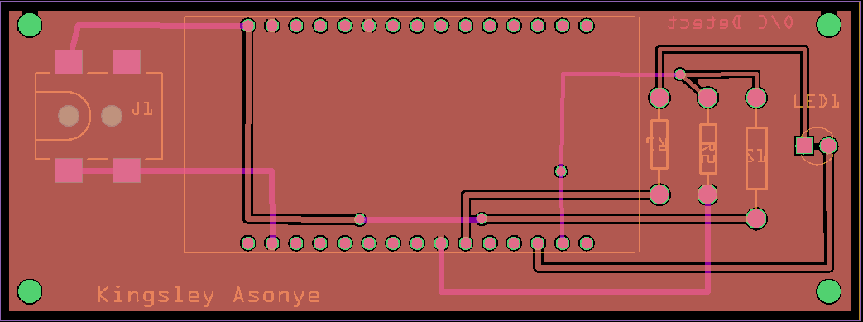
Implementation of Task 8.2
PCB Design of Open/Close Detection System
PCB Design of the Open/Close Detection System

Slide 45
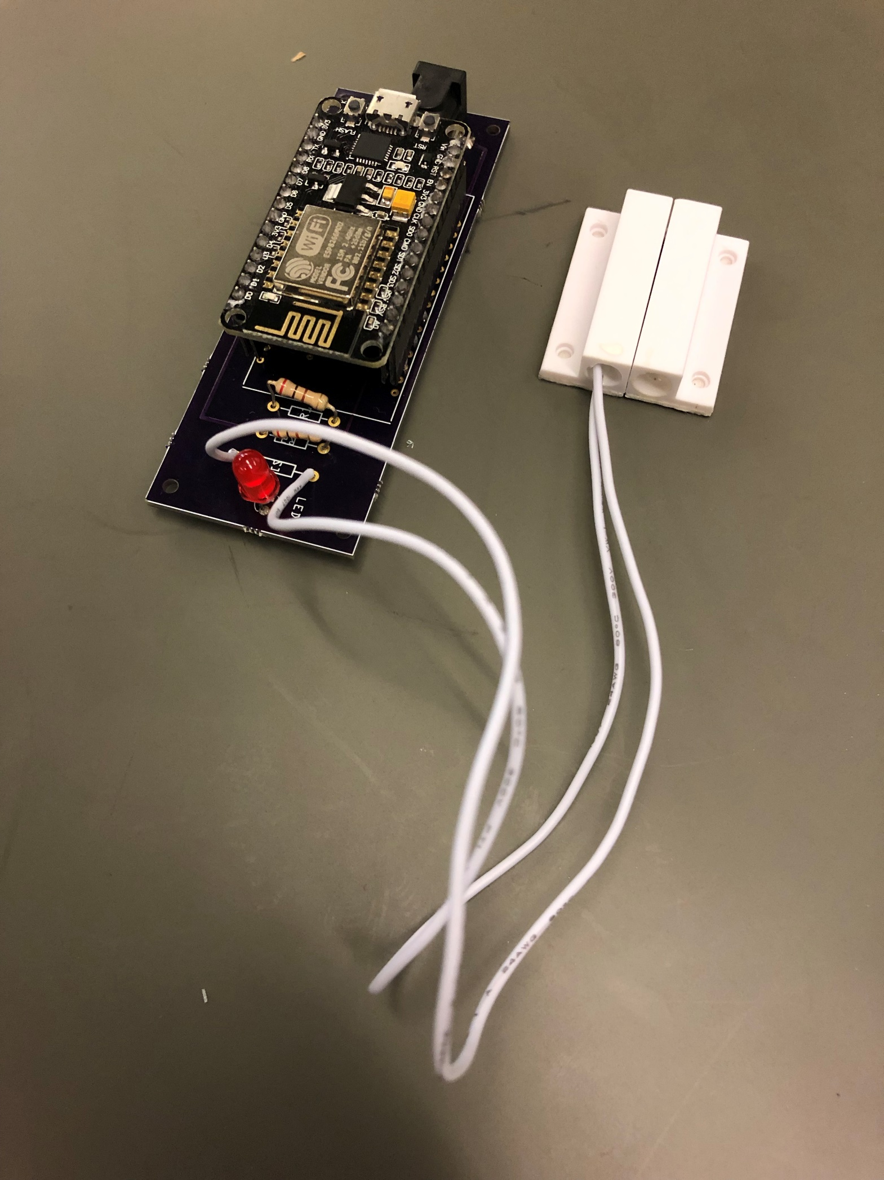
Implementation of Task 8.3
Soldered components to PCB for Door Sensor

Slide 46
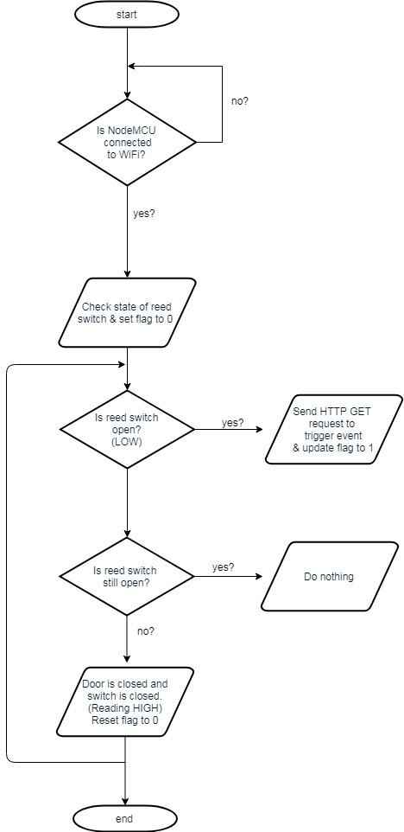
Implementation of Task 8.4
Program NodeMCU for Door Sensor Design

Slide 47
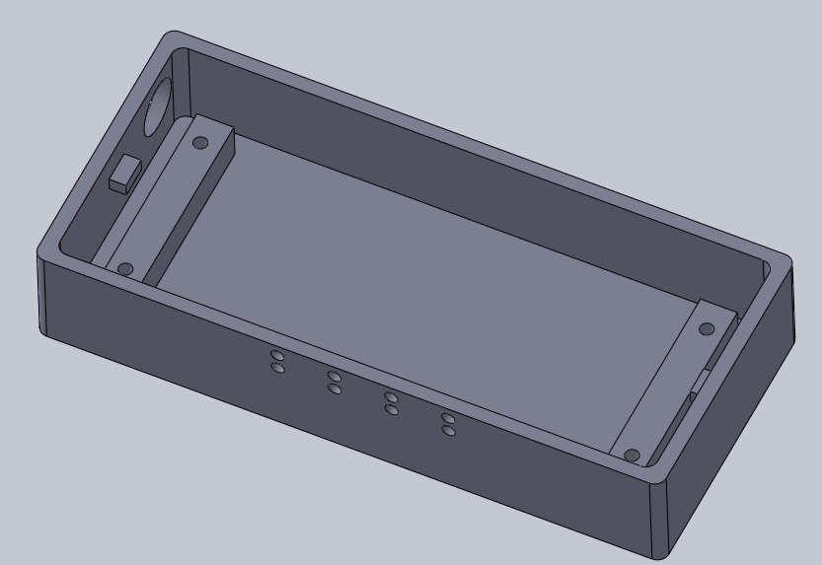
Implementation of Task 8.5
Encasing Design of Open Close Detection

Slide 48
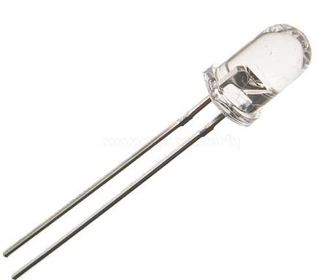
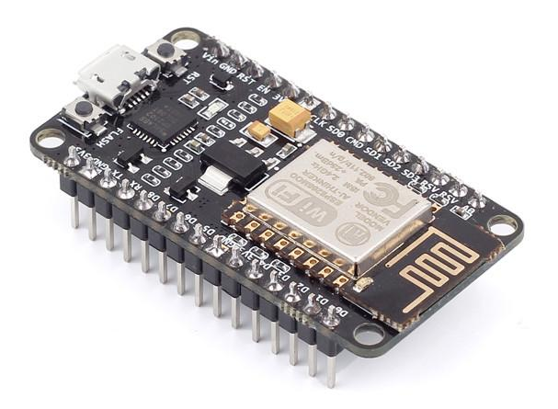
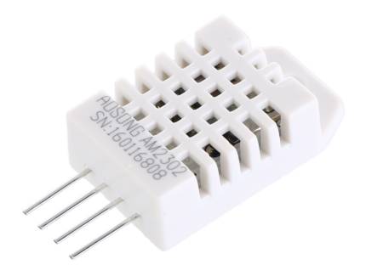
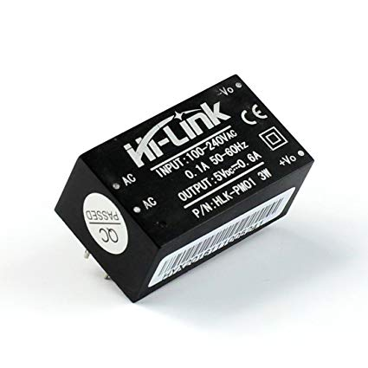
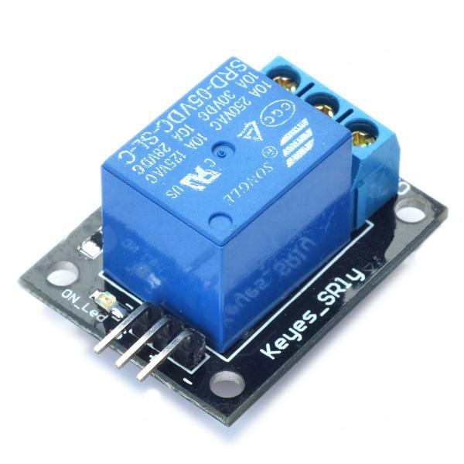
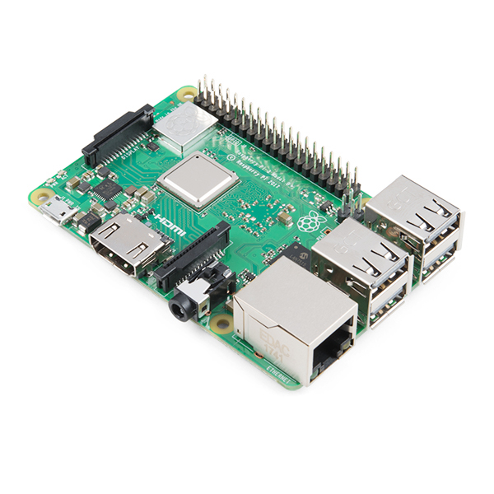



Slide 49


ABET Outcomes
(a) An ability to apply knowledge of mathematics, science, and engineering
(b) An ability to design and conduct experiments, as well as to analyze and interpret data
(c) An ability to design a system, component, or process to meet desired needs within realistic constraints such as economic, environmental, social, political, ethical, health and safety, manufacturability, and sustainability
(d) An ability to function on multidisciplinary teams
(e) An ability to identify, formulate, and solve engineering problems
(f) An understanding of professional and ethical responsibility
(g) An ability to communicate effectively
(h) The broad education necessary to understand the impact of engineering solutions in a global, economic, environmental, and societal context
(i) A recognition of the need for, and an ability to engage in life-long learning
(j) A knowledge of contemporary issues
(k) An ability to use the techniques, skills, and modern engineering tools necessary for engineering practice.

Slide 50
Acknowledgements
Dr. Alvernon Walker – Electrical Engineering Professor
Justin Derickson – Electrical Engineering Student
Nathan Bane – Electrical Engineering Student
Christopher Blanks – Electrical Engineering Student
Joshua Orebiyi – Mechanical Engineering Student
Tochi Chukwu – Mechanical Engineering Student

Slide 51
Conclusion
Throughout conducting this project, we have learned technical skills like the PCB design process. Also how cloud computing works with AWS Lambda and the different REST HTTP methods that were required to complete our project. We also learned that success does not come without failure. There were several times during this project that things did not go according to the plan that we set. We were forced to find alternative solutions to counter each problem.

Slide 52
Thank You!

